Slide 1
Trends in Embedded Computing
The Ubiquitous Computing through Sensor Swarms

Slide 2
“The most profound technologies are those that disappear. They weave themselves into the fabric of everyday life until they are indistinguishable from it.”
In 1991, Mark Weiser, chief technology officer for Xerox’s Palo

Slide 3
Definitions
Ubiquitous computing is the method of enhancing
computer use by making many computers available
throughout the physical environment, but making them
effectively invisible to the user
– Mark Weiser
Ubiquitous computing, or calm technology, is a
paradigm shift where technology becomes virtually
invisible in our lives.
-- Marcia Riley
(Georgia Institute of Technology, Atlanta.)

Slide 4
Universal Computing Environment
Games
Wash Machine
Lighting
Audio
Cooker
Digital Camera
DVD
Printer
PDA
PC
Scanner
NOTEBOOK
Disk Drives

Slide 5
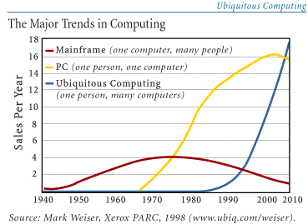

Slide 6
Computing Everywhere
giving machines the ability to detect, track, and identify people
to interpret human behavior
This technology is “fourth generation” embedded computing: “smart”’ environments and portable or wearable devices.

Slide 7
Goals
The key technical goal is
to determine the computer’s context with respect to nearby humans who, what, when, where, and why
so that the computer can act or respond appropriately without detailed instructions.

Slide 8
The Issues
the problem of context sensing, which is closely related to the famous frame problem of AI,’ has become a critical problem
The frame problem is that specifying only which conditions are changed by the actions do not allow, in logic, to conclude that all other conditions are not changed.

Slide 9
Areas
person identification
surveillance/monitoring,
3D methods
smart rooms
perceptual user interfaces

Slide 10
Users Interface
The multitude of different Ubicomp devices with their different sizes of displays and interaction capabilities represents another challenge
Mouse
keyboard
Pen
Gesture recognition
…

Slide 11
Is it Possible with the present state of art technology growth??

Slide 12
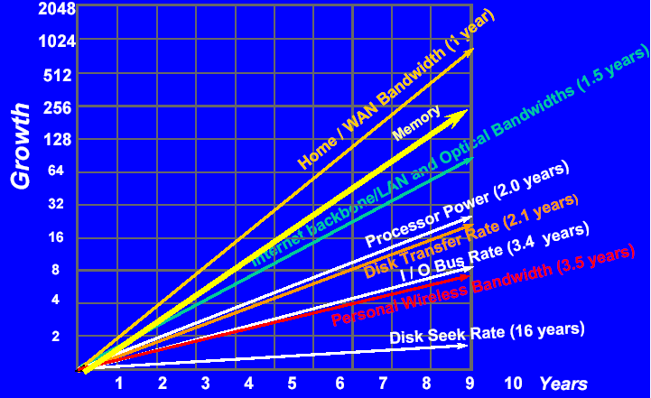

Slide 13
Sensors
Sensor Networks
Sensor Swarms

Slide 14
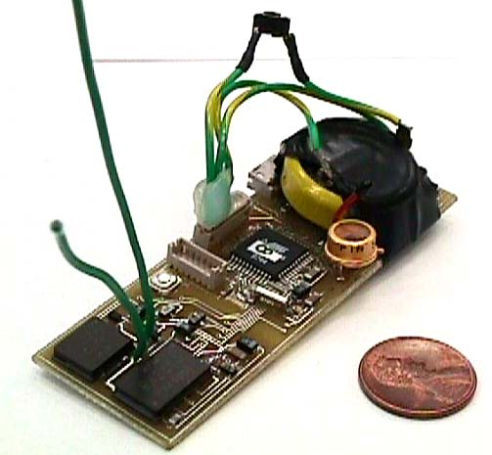
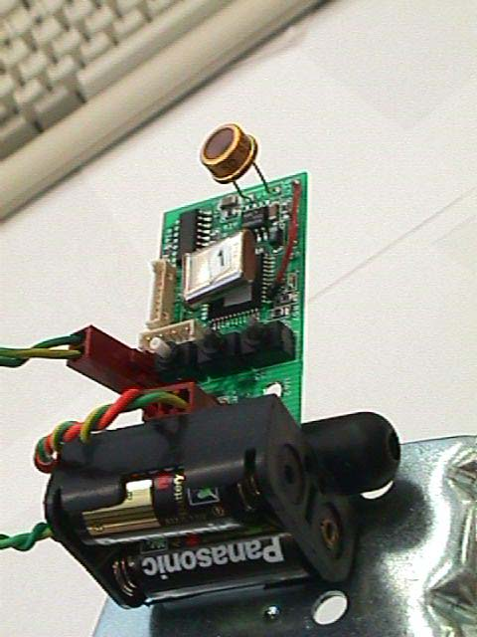
Berkley Dust

Slide 15
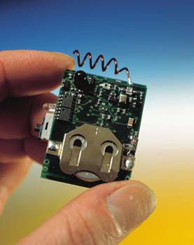
VTT Soap Box
Basic board:
  Bidirectional, single channel 868 MHz short range radio
  Microcontroller
  Real-time clock
  Calendar circuit
Sensor board:
  3-axis acceleration sensors
  electronic compass
  lighting sensor
  optic IR-based proximity detector

Slide 16
perceptual user interface
Facial expression
Hand Gestures
Whole-body movement
Voice

Slide 17
Our Effort in this Direction
Real Time Signal Processing
Real Time Signal Analysis
  Real Time Matrix Analysis
    Eigen Value Problems
  Real Time Optimization
Emotion/Fatigue/Stress Analysis from Speech
Real Time Video Processing
Real Time Video Analysis
Fatigue/Emotion/Stress Analysis

Slide 18
Real Time Singular Value Decomposition
Face Recognition
Principal Component Analysis
Speech Processing
Signal Analysis
De-noising
Data Compression
Page Ranking

Slide 19
Real Time SVD (key issues)
Speed
Accuracy
Power Consumption

Slide 20
Our Implementation Trials
Desktop
  Pentium Dual Processor
TI6713 Floating point DSP
TI5000 series Fixed Point DSP

Slide 21
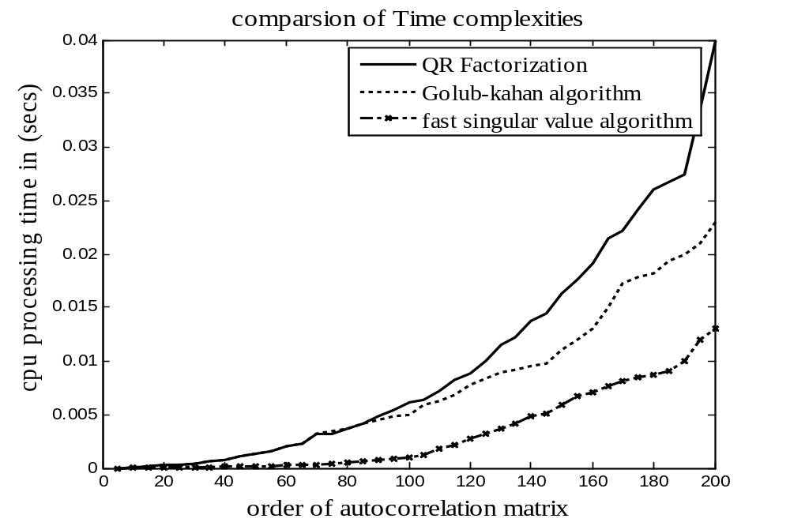
Comparative Assessment of SVD Algorithms on Floating Point Processor

Slide 22
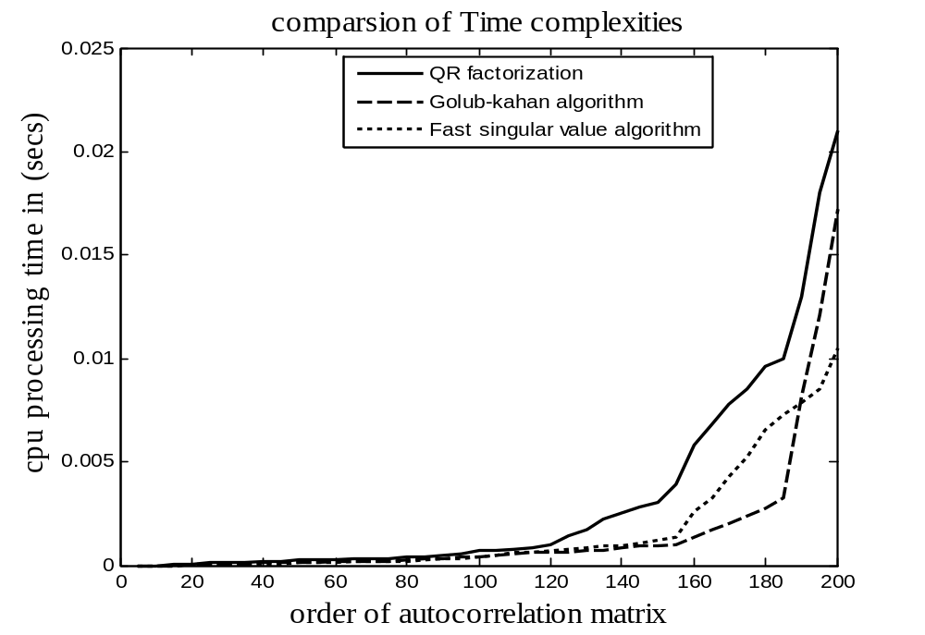
Comparative Assessment of SVD Algorithms on Fixed Point Processor

Slide 23
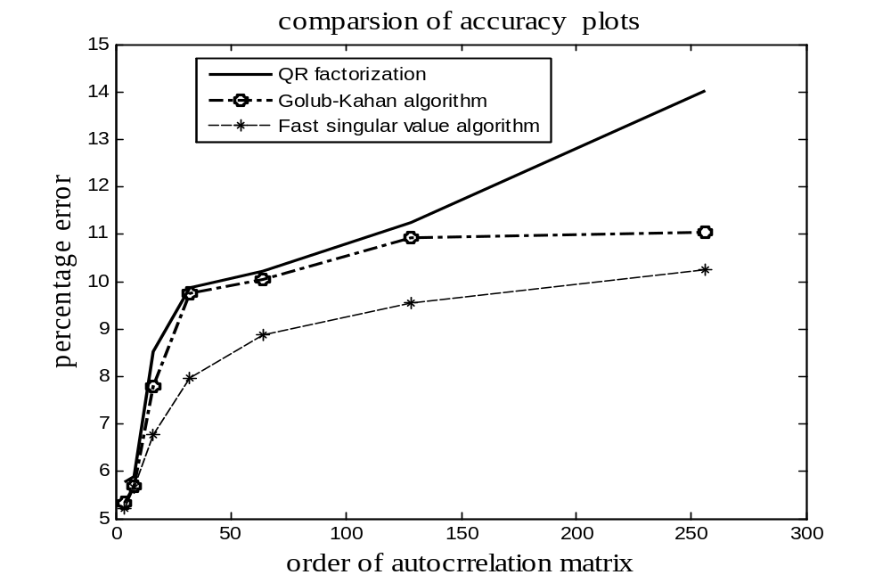
Comparative Accuracy

Slide 24
Designing Power Efficient Algorithms

Slide 25
Why Power Efficiency in Low Power
Stand Alone Systems
Battery Driven
Battery capacity is limited
It is possible to decrease the Battery discharge rate by Intelligent use of its power
  DVS: stands for Dynamic Voltage Switching
  Hardware: reconfiguration and intelligent clock throttling
  Software: Code Size Minimization and Run Time optimization

Slide 26
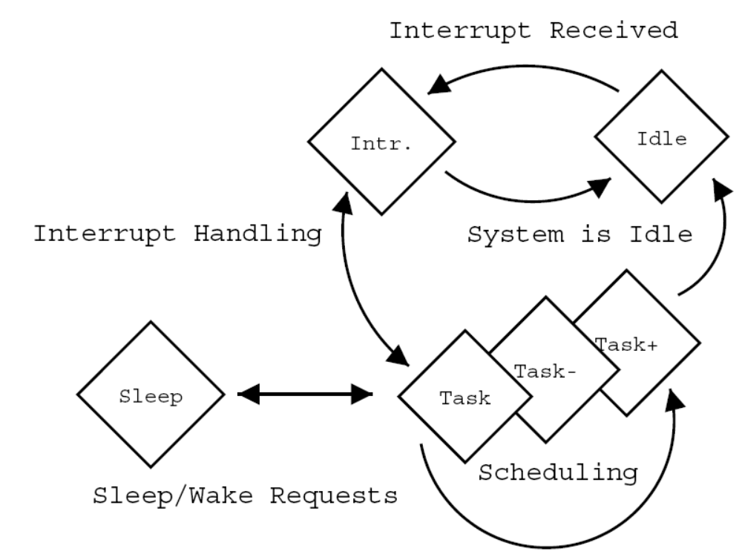
Typical State Transitions for Power Saving

Slide 27
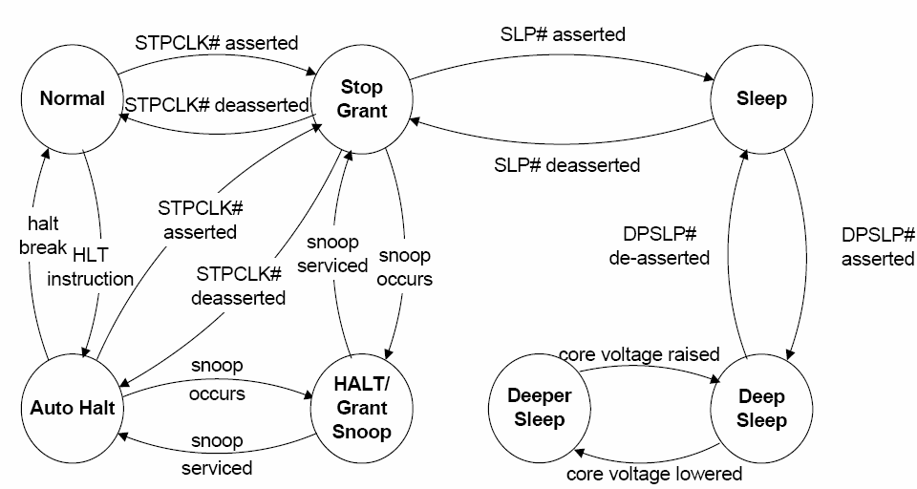
Power Management in Pentium M

Slide 28
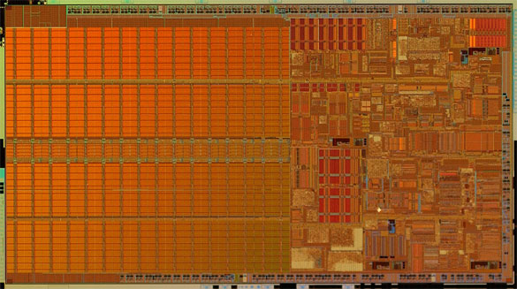
Intel 90 nm – Pentium M Processor (2 MB cache)

Slide 29
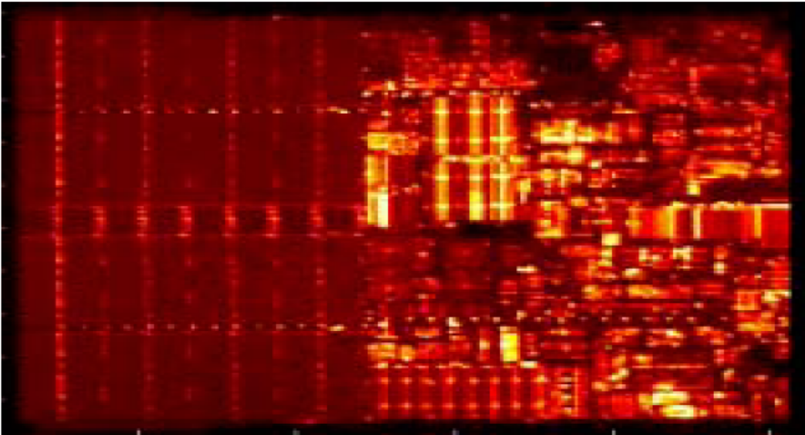
Power Density in Pentium M by
Infra-Red Emission Microscopy

